Slide 1
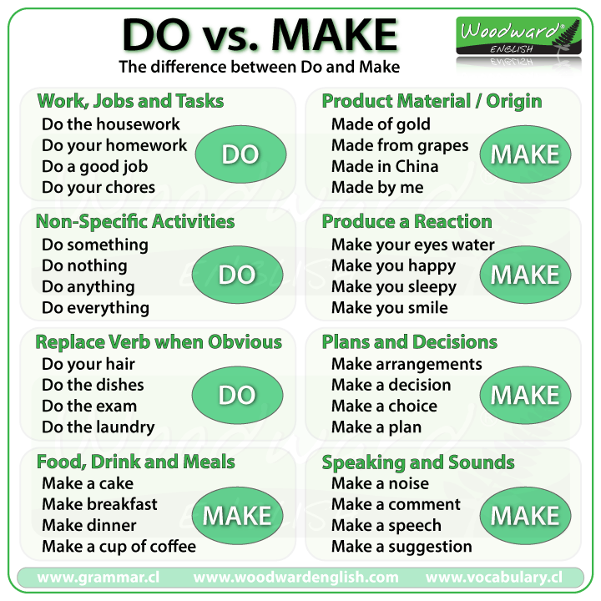

Slide 2
DO
WORK, JOB, STH
List of household chores: do the cleaning, do washing up, do vacuum/Hoovering…
MAKE the bed
do some research, do your hw, do paper work, do the filling…
Have nothing to do, we need to do sth…
Do your best, do someone a favour, do your make up/nails…

Slide 3
MAKE
CREATIVITY
Make a cake, a plan, a list, some decorations, a tree house…
FIXED EXPRESSIONS
Make progress, make a mess, make a complain, make an excuse, make a speech, make my day, friends, an appointment, a suggestion, a mistake, breakfast, an offer, an excuse, a trip, love, the best of sth, plans…

Slide 4
Do sth!
Make sth of yourself (become successful)
“hard work will let you make something of yourself”

